Slide 1
Semantic Analysis: Syntax Directed Translation

Slide 2
Program is lexically well-formed:
Identifiers have valid names
Strings are properly terminated
No stray characters
Program is syntactically well-formed:
Class declarations have the correct structure
Expressions are syntactically valid
Does this mean that the program is legal?

Slide 3
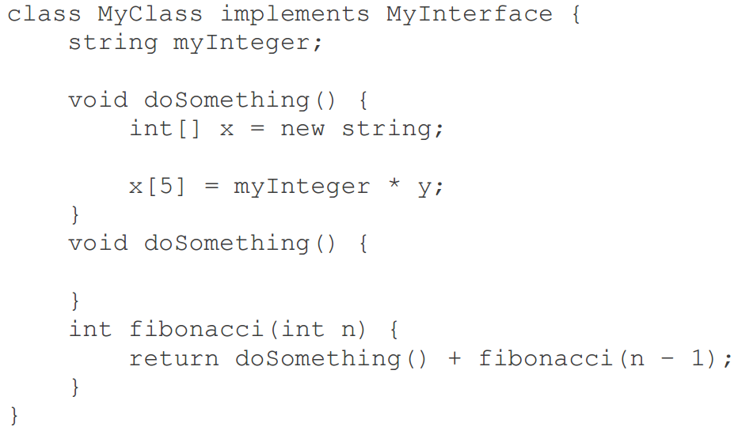

Slide 4
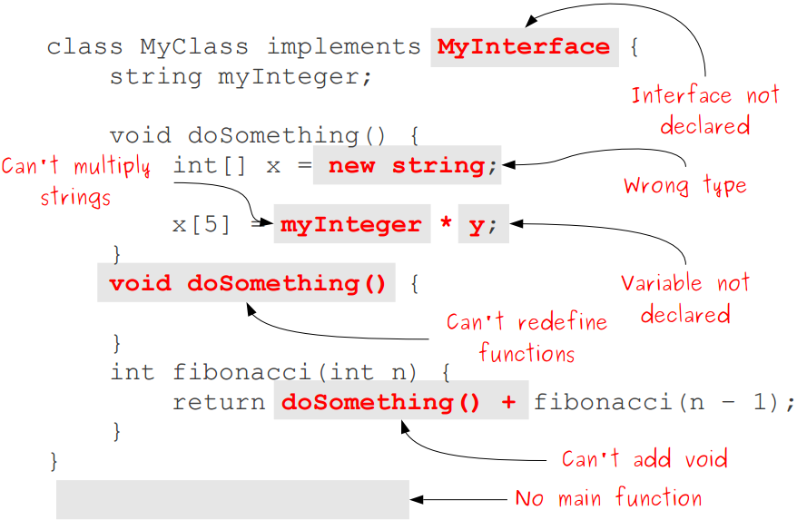

Slide 5
Semantic Analysis
Ensure that the program has a well-defined meaning
Verify properties of the program that aren't caught during the earlier phases:
Variables are declared before they're used.
Expressions have the right types.
Arrays can only be instantiated with NewArray.
Classes don't inherit from nonexistent base classes …
Once we finish semantic analysis, we know that the user's input program is legal

Slide 6
Challenges in Semantic Analysis
Reject the largest number of incorrect programs
Accept the largest number of correct programs
Do so quickly
Gather useful information about program for later phases:
Determine what variables are meant by each identifier.
Build an internal representation of inheritance hierarchies.
Count how many variables are in scope at each point

Slide 7
Semantic Analysis
Semantic Analysis computes additional information related to the meaning of the program once the syntactic structure is known
In typed languages as C, semantic analysis involves
adding information to the symbol table and
performing type checking
As for Lexical and Syntax analysis, also for Semantic Analysis we need both a Representation Formalism and an Implementation Mechanism

Slide 8
Syntax Directed Translation: Intro
The Principle of Syntax Directed Translation states that the meaning of an input sentence is related to its syntactic structure, i.e., to its Parse-Tree
By Syntax Directed Translations we indicate those formalisms for specifying translations for programming language constructs guided by context-free grammars
We associate Attributes to the grammar symbols representing the language constructs
Values for attributes are computed by Semantic Rules associated with grammar productions

Slide 9
Syntax Directed Translation: Intro
We can associate information with a language construct by attaching attributes to the grammar symbols.
A syntax directed definition specifies the values of attributes by associating semantic rules with the grammar productions
Production
Semantic Rule
E->E1+T
E.code=E1.code||T.code||’+’
We may alternatively insert the semantic actions inside the grammar
E -> E1+T {print ‘+’}

Slide 10
Syntax Directed Translation: Intro (Cont.)
Evaluation of Semantic Rules may:
Generate Code
Insert information into the Symbol Table
Perform Semantic Check
Issue error messages; etc

Slide 11
Syntax Directed Translation: Intro (Cont.)
When we associate semantic rules with productions, we use two notations:
Syntax Directed Definitions
give high-level specifications for translations
hide many implementation details
Translation Schemes
indicate the order of evaluation of semantic actions associated with a production rule
In other words, translation schemes give a little bit information about implementation details

Slide 12
Syntax Directed Translation
Conceptually with both the syntax directed translation and translation scheme we
Parse the input token stream
Build the parse tree
Traverse the tree to evaluate the semantic rules at the parse tree nodes
Input string parse tree dependency graph
evaluation order for semantic rules
Conceptual view of syntax directed translation

Slide 13
Syntax Directed Definitions
Syntax Directed Definitions are a generalization of context-free grammars in which:
Grammar symbols have an associated set of Attributes
Productions are associated with Semantic Rules for computing the values of attributes
Such formalism generates Annotated Parse-Trees where each node of the tree is a record with a field for each attribute (e.g., X.a indicates the attribute a of the grammar symbol X).

Slide 14
Attribute Grammars
Both semantic analysis and (intermediate) code generation can be described in terms of annotation, or "decoration" of a parse or syntax tree
ATTRIBUTE GRAMMARS provide a formal framework for decorating such a tree

Slide 15
Attribute Grammars
E → E + T E → E – T E → T T → T * F T → T / F T → F F → - F F → (E) F → const
This says nothing about what the program MEANS

Slide 16
Attribute Grammars
We can turn this into an attribute grammar as follows : E → E + T E1.val = E2.val + T.val E → E – T E1.val = E2.val - T.val E → T E.val = T.val T → T * F T1.val = T2.val * F.val T → T / F T1.val = T2.val / F.val T → F T.val = F.val F → - F F1.val = - F2.val F → (E) F.val = E.val F → const F.val = C.val

Slide 17
Attribute Grammars
The attribute grammar serves to define the semantics of the input program
The process of evaluating attributes is called annotation, or DECORATION, of the parse tree
The code fragments for the rules are called SEMANTIC FUNCTIONS

Slide 18
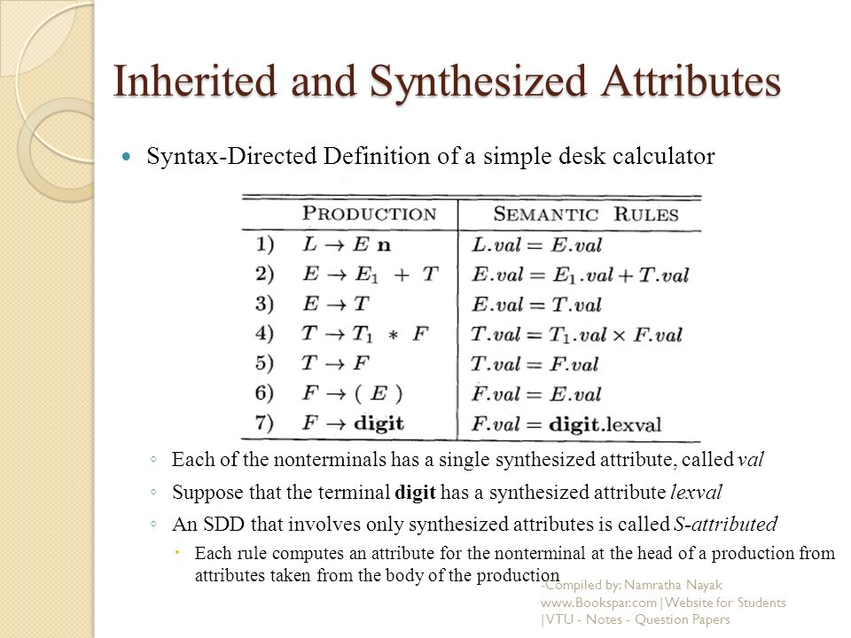

Slide 19
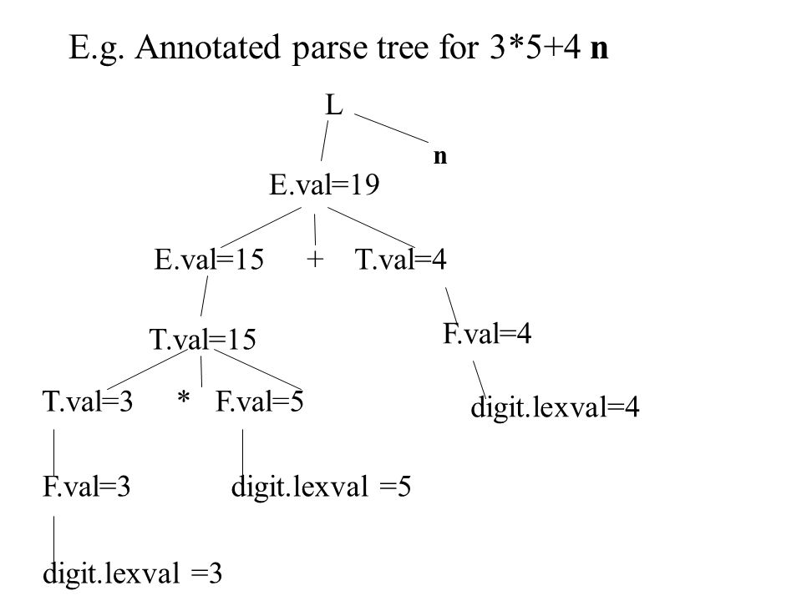
Example: 5.2
Each of the nodes for the non-terminals has attribute val computed in a bottom-up order, and we see the resulting values associated with each node

Slide 20
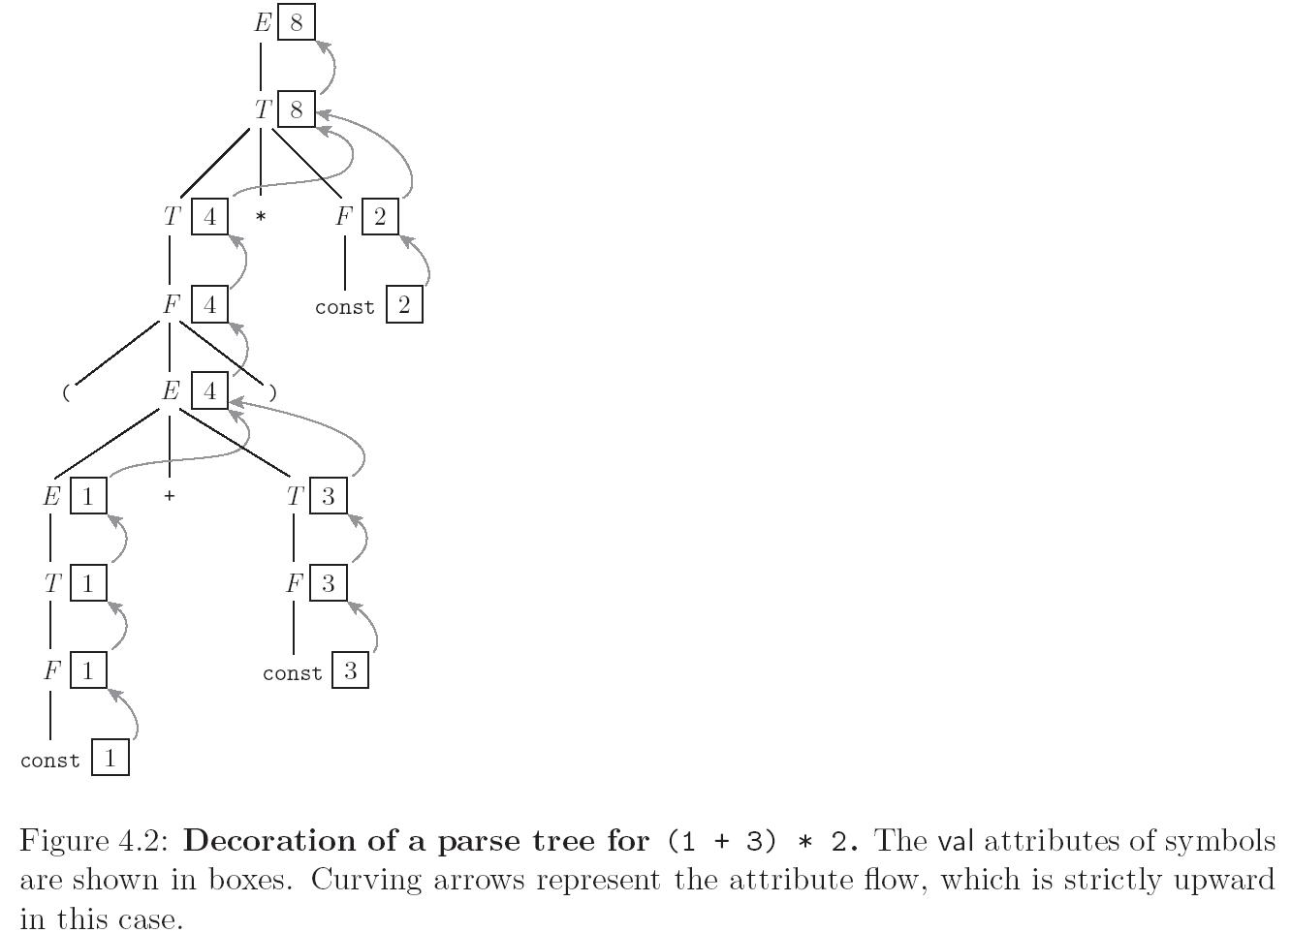
Evaluating Attributes

Slide 21
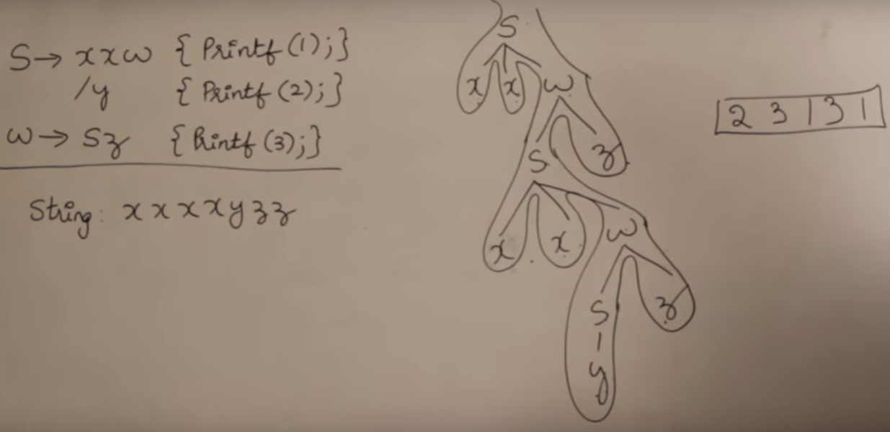

Slide 22
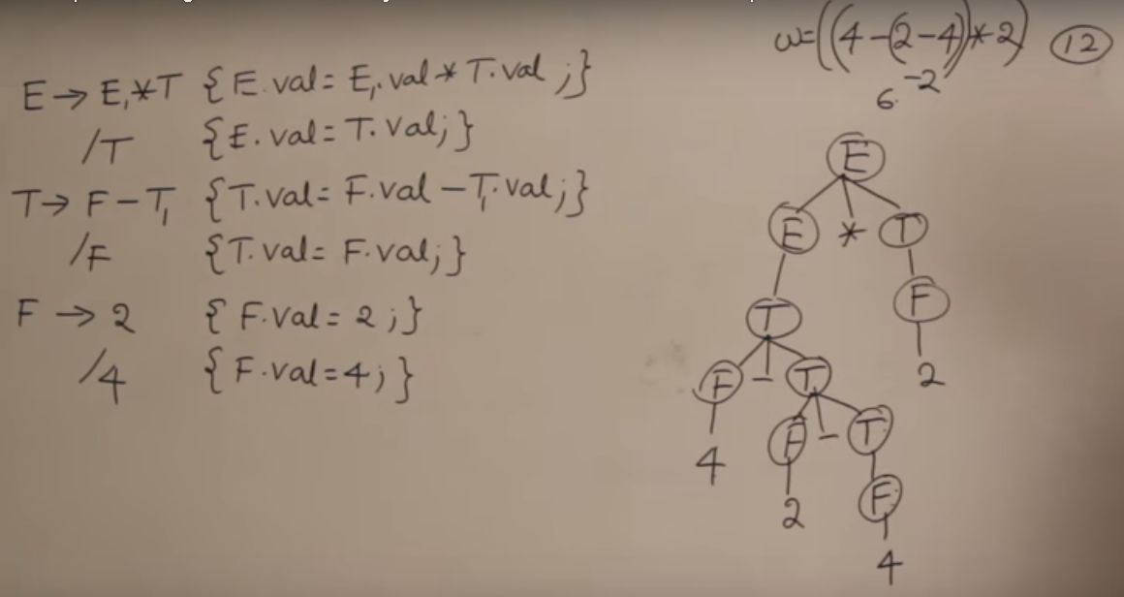

Slide 23
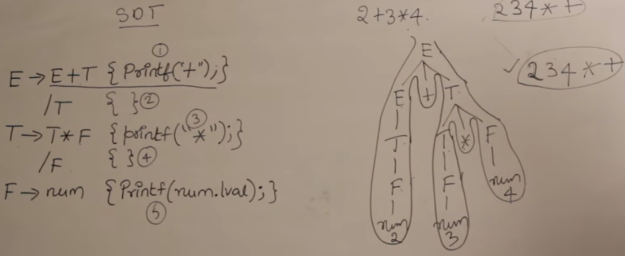
https://www.youtube.com/watch?v=queUceGJqh0

Slide 24
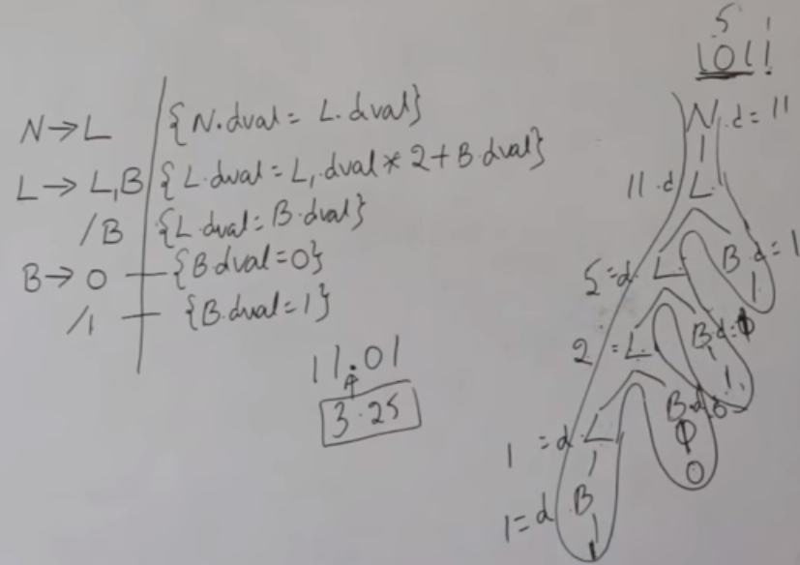
https://www.youtube.com/watch?v=fmRgKPLEROg&t=106s

Slide 25
Syntax Directed Definitions (Cont.)
The value of an attribute of a grammar symbol at a given parse-tree node is defined by a semantic rule associated with the production used at that node
We distinguish between two kinds of attributes:
Synthesized Attributes: A synthesized attribute at node N is defined only in terms of attribute values of children of N and at N itself
Inherited Attributes: An inherited attribute at node N is defined only in terms of attribute values at parent of N, N itself and siblings of N

Slide 26
Inherited and Synthesized Attributes
A synthesized attribute for a non-terminal A at a parse-tree node N is defined by
a semantic rule associated with the production at N
Note that the production must have A as its head
A synthesized attribute at node N is defined only in terms of attribute values at the children of N and at N itself

Slide 27
Inherited and Synthesized Attributes
An inherited attribute for a non-terminal B at a parse-tree node N is defined by
A semantic rule associated with the production at the parent of N
Note that the production must have B as a symbol in its body
An inherited attribute at node N is defined only in terms of attribute values at parent of N, N itself and siblings of N

Slide 28
Inherited and Synthesized Attributes
Terminals can have synthesized attributes, which are given to it by the lexer (not the parser)
There are no rules in an SDD giving values to attributes for terminals
Terminals do not have inherited attributes
A non-terminal can have both inherited and synthesized attributes

Slide 29
Evaluating an SDD at the Nodes of a Parse Tree
Parse tree helps us to visualize the translation specified by SDD
The rules of an SDD are applied by first constructing a parse tree
then using the rules to evaluate all of the attributes at each of the nodes of the parse tree
A parse tree, showing the value(s) of its attribute(s) is called an annotated parse tree

Slide 30
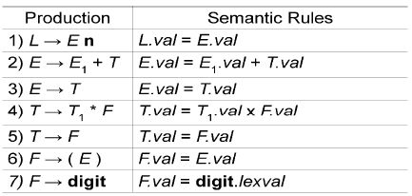
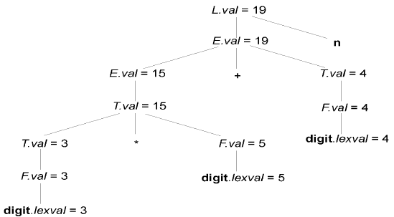
Evaluating an SDD at the Nodes of a Parse Tree
val and lexval are synthesized attributes
Annotated parse tree: 3*5 + 4 n
With synthesized attributes, we can evaluate attributes in any bottom-up order, such as that of a postorder traversal of the parse tree

Slide 31
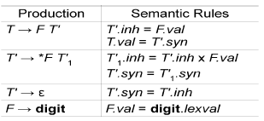
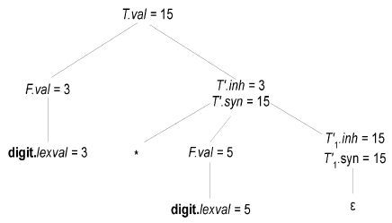
Evaluating an SDD at the Nodes of a Parse Tree
Show how semantic rules are used in an annotated parse tree: 3*5
An SDD with both inherited and synthesized attributes does not ensure any guaranteed order; even it may not have an order at all

Slide 32
S-Attributed Definitions
An SDD is S-attributed if every attribute is synthesized
Attributes of an S-attributed SDD can be evaluated in bottom-up order of the nodes of parse tree
Evaluation is simple using post-order traversal
A syntax directed translation that uses synthesized attributes exclusively is said to be a S-attributed definition
A parse tree for a S-attributed definition can be annotated by evaluating the semantic rules for the attributes at each node, bottom up from leaves to the root

Slide 33
L-Attributed Definitions
Each attribute must be either
Synthesized, or
Inherited, but with the rules limited as follows:
Suppose that there is a production A X₁ X₂ … X_{n}, there is an inherited attribute X_{i}.a computed by a rule associated with this production, Then the rule may use only:
Inherited attributes associated with the head A
Either inherited or synthesized attributes associated with the occurrences of symbols X₁ X₂ … X_{i-1} located to the left of X_{i}
Inherited or synthesized attributes associated with this occurrence of X_{i} itself, but only in such a way that there are no cycles in a dependency graph formed by the attributes of this X_{i}

Slide 34
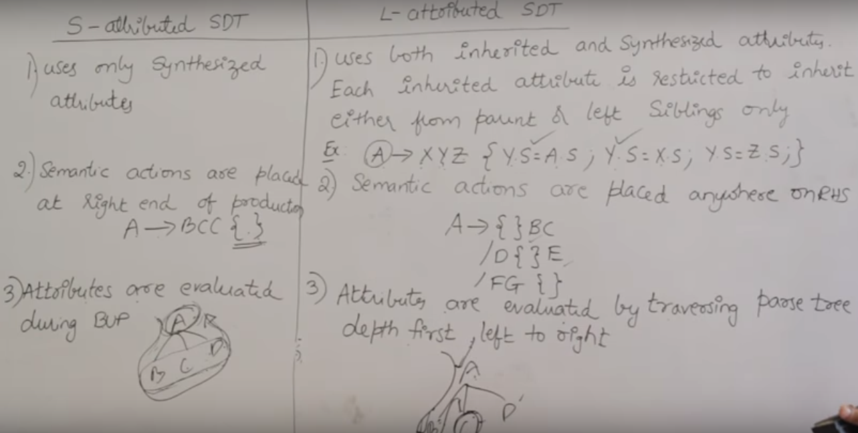
https://www.youtube.com/watch?v=rdnAJBoFKOw&t=770s

Slide 35
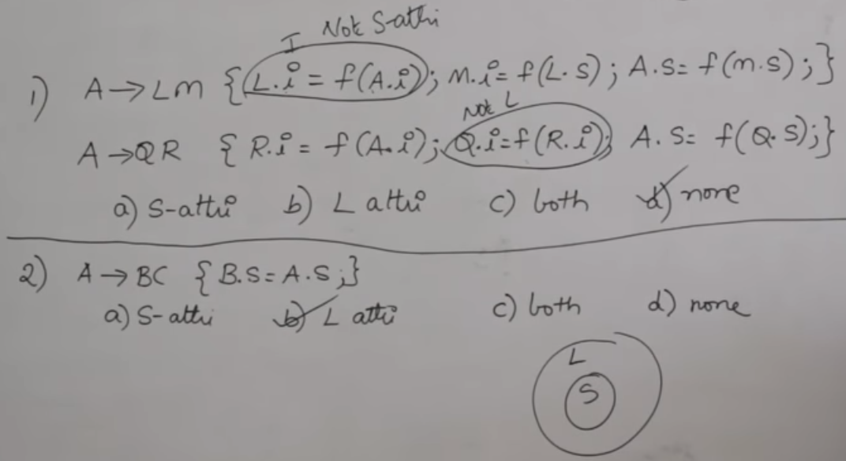
https://www.youtube.com/watch?v=rdnAJBoFKOw&t=770s

Slide 36
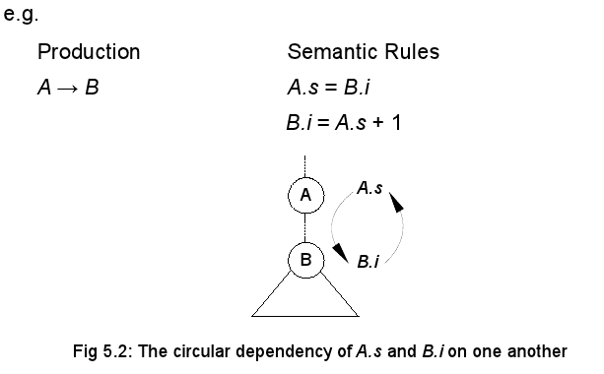
Evaluating an SDD at the Nodes of a Parse Tree

Slide 37
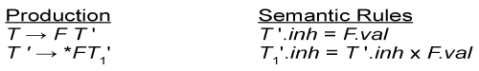
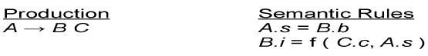
L-Attributed Definitions-Example

Slide 38
Evaluation Orders for SDD's
"Dependency graphs" are a useful tool for determining an evaluation order for the attribute instances in a given parse tree.
While an annotated parse tree shows the values of attributes
A dependency graph helps us determine how those values can be computed

Slide 39
Evaluation Orders for SDD's
Each attribute is associated to a node
If a semantic rule associated with a production p defines the value of synthesized attribute A.b in terms of the value of X.c, then graph has an edge from X.c to A.b
If a semantic rule associated with a production p defines the value of inherited attribute B.c in terms of value of X.a, then graph has an edge from X.a to B.c

Slide 40
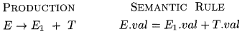
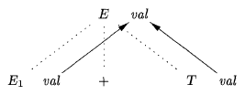
Evaluation Orders for SDD's
At every node N labeled E with children correspond to the body of production,
The synthesized attribute val at N is computed using the values of val at the two children, labeled E and T

Slide 41
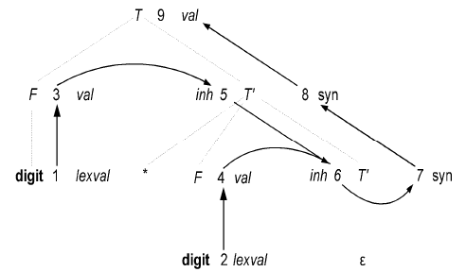
Evaluation Orders for SDD's
Dependency graph for the annotated parse tree for string: 3*5

Slide 42
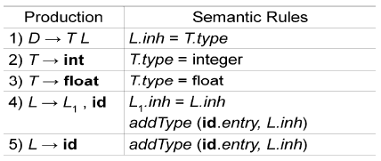
SDD For Simple Type Declarations
The purpose of L.inh is to pass the declared type down the list of identifiers, so that it can be the appropriate symbol-table entries
Productions 2 and 3 each evaluate the synthesized attribute T.type, giving it the appropriate value, integer or float
Productions 4 and 5 also have a rule in which a function addType is called with two arguments
1. id.entry, a lexical value that points to a symbol-table object, and
2. L.inh, the type being assigned to every identifier on the list
The function addType properly installs the type L.inh as the type of the represented identifier

Slide 43
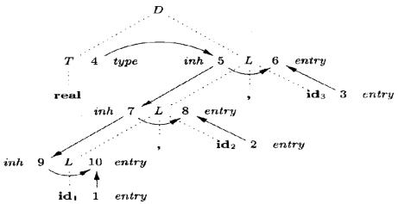
Dependency Graph For Simple Type Declarations
A dependency graph for the input string: float id1 , id 2, id3

Slide 44
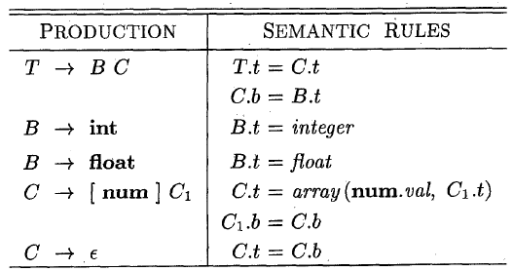
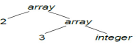
The structure of a TYPE
In C, the type int [2][3] can be read as, "array of 2 arrays of 3 integers." The corresponding type expression array(2, array(3, integer)) is represented by the tree as shown below.

Slide 45
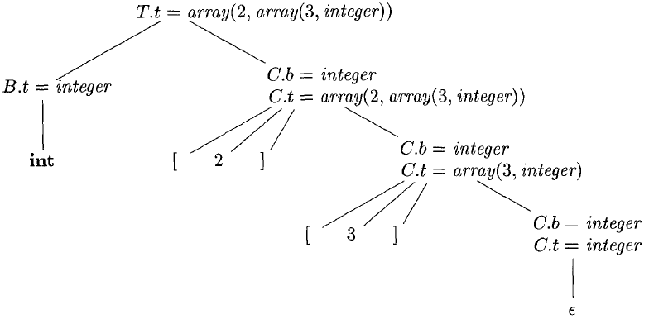
The structure of a TYPE
An annotated parse tree for the input string int [2][3] is shown below.

Slide 46
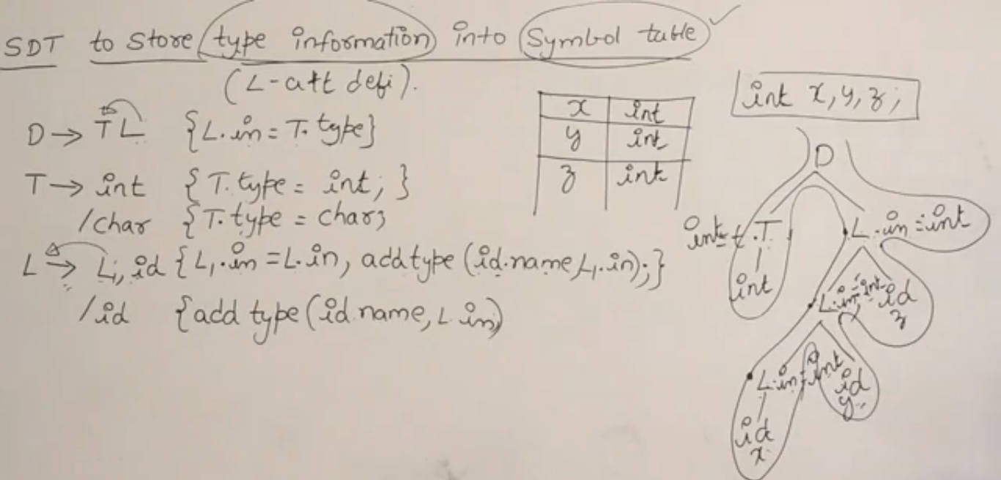
https://www.youtube.com/watch?v=v_ZYcjj7rN8

Slide 47
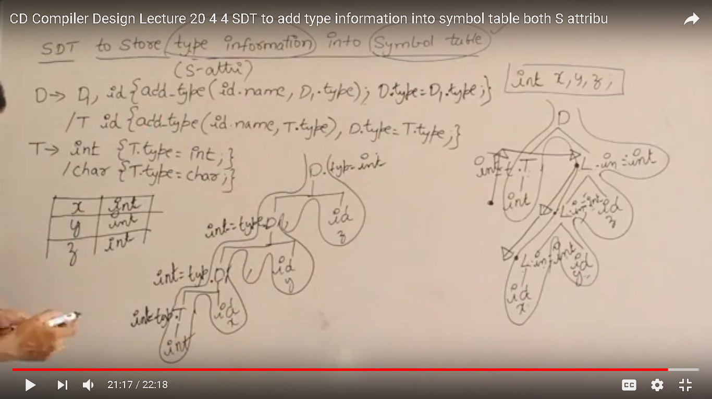

Slide 48
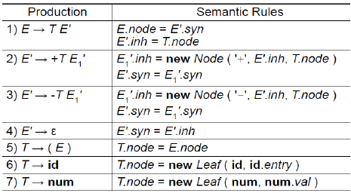
Constructing Syntax Trees during Top-Down Parsing

Slide 49
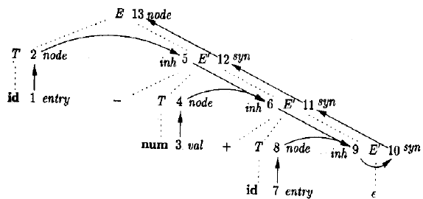
Constructing Syntax Trees during Top-Down Parsing

Slide 50
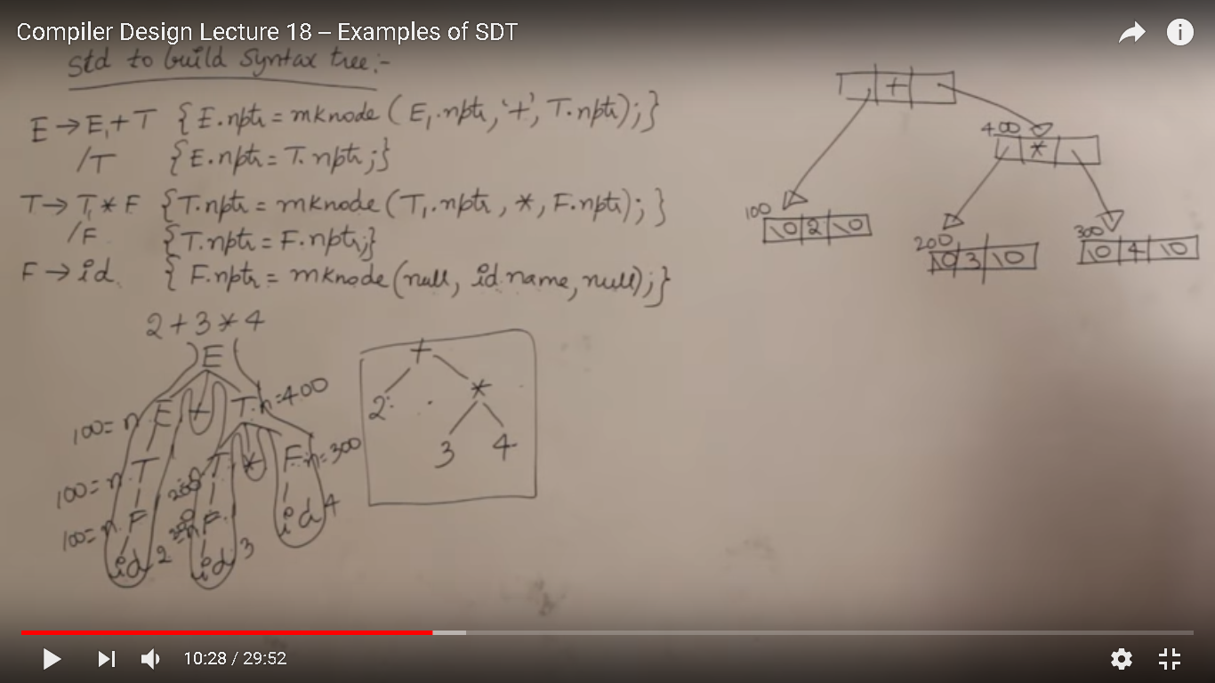
https://www.youtube.com/watch?v=fmRgKPLEROg&t=106s

Slide 51
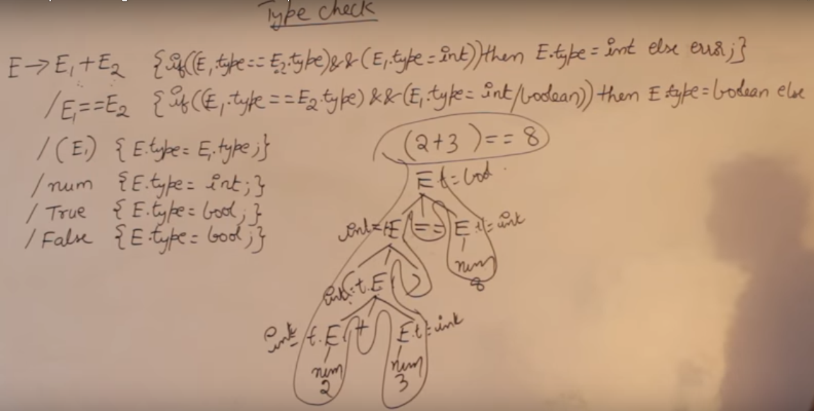
https://www.youtube.com/watch?v=fmRgKPLEROg&t=106s

Slide 52
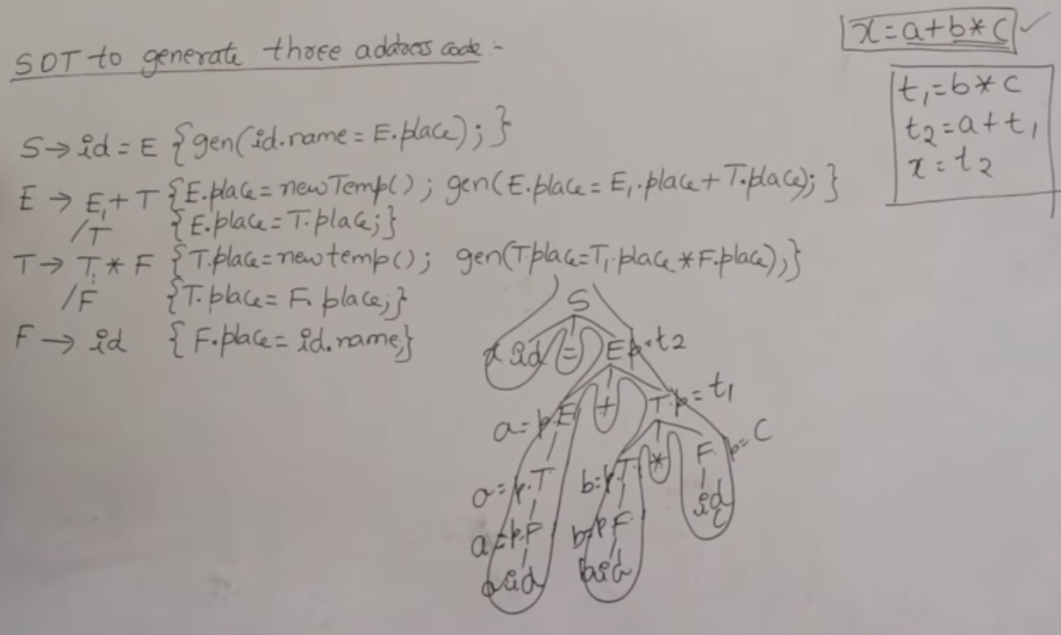
https://www.youtube.com/watch?v=rdnAJBoFKOw&t=770s

Slide 53

Any Question?

